Slide 1
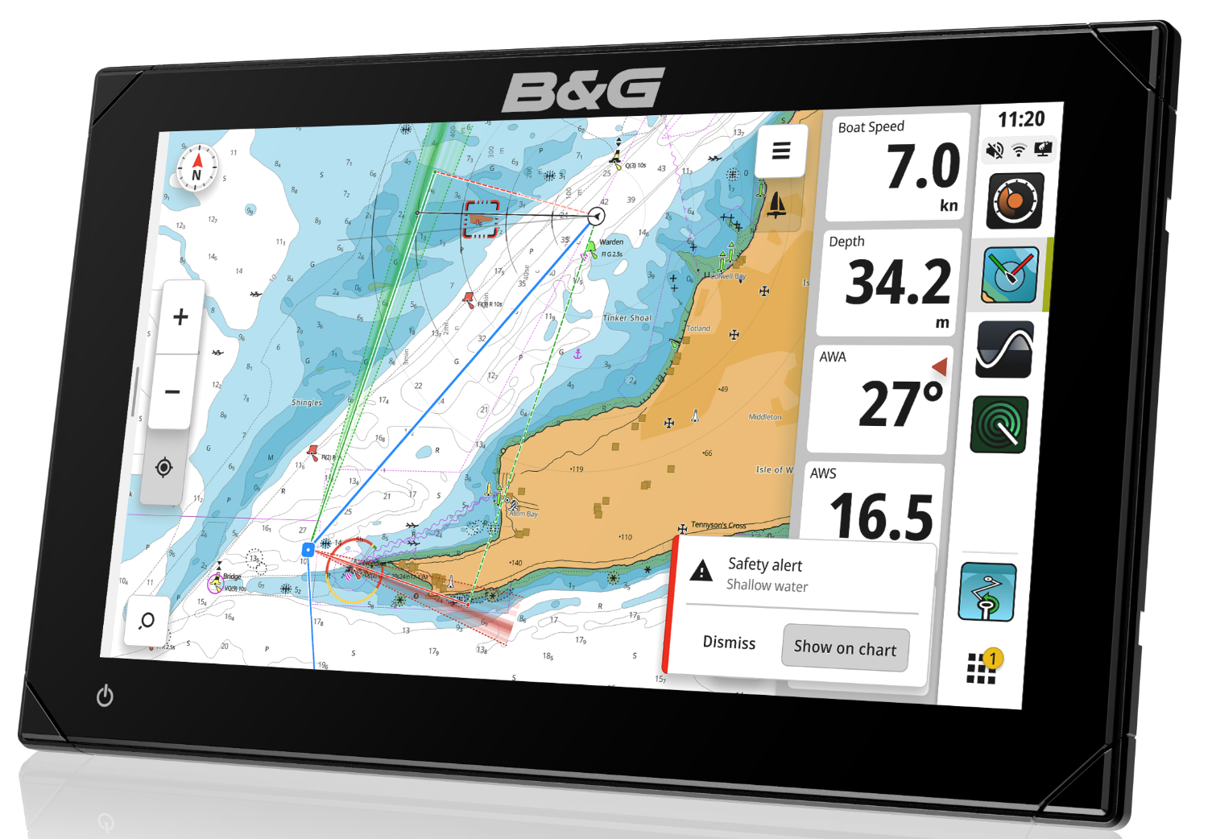
Zeus® S
Sailing chart plotter
SAILING NAVIGATION REIMAGINED
CRUISE & RACE
MONOHULL & MULTIHULL
TOTAL SYSTEM INTEGRATION
7, 9 & 12” DISPLAYS
Navigation Systems | Sailing Chart plotter | Zeus® S

Slide 2
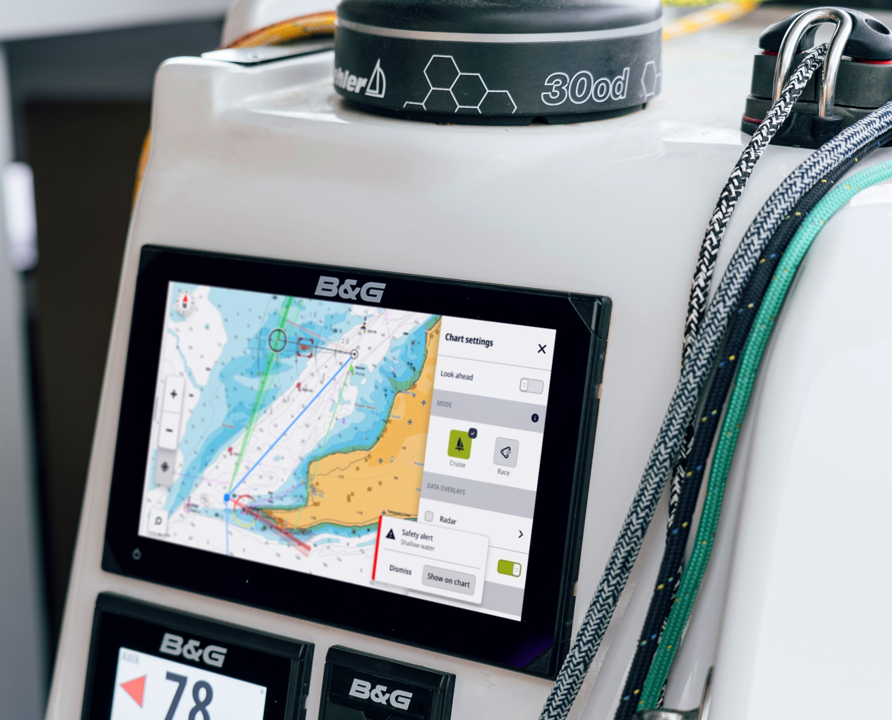
Zeus® S - Introduction
Introducing B&G’s all-new B&G Zeus® S sailing chart plotter.
The Zeus® S has been designed with the cruiser, racer, monohull and multihull sailor in mind, providing a new intuitive user experience with user modes to easily get the best experience whilst sailing.
The bright, sunlight viewable, touch screen combined with the new C-MAP® X cartography enables new features and each sailing feature has been reimagined to be more capable and more intuitive.
All powered by the latest quad-core micro processors that allow Instrument, Radar, Sonar and Charting features to all work seamlessly together.

Slide 3
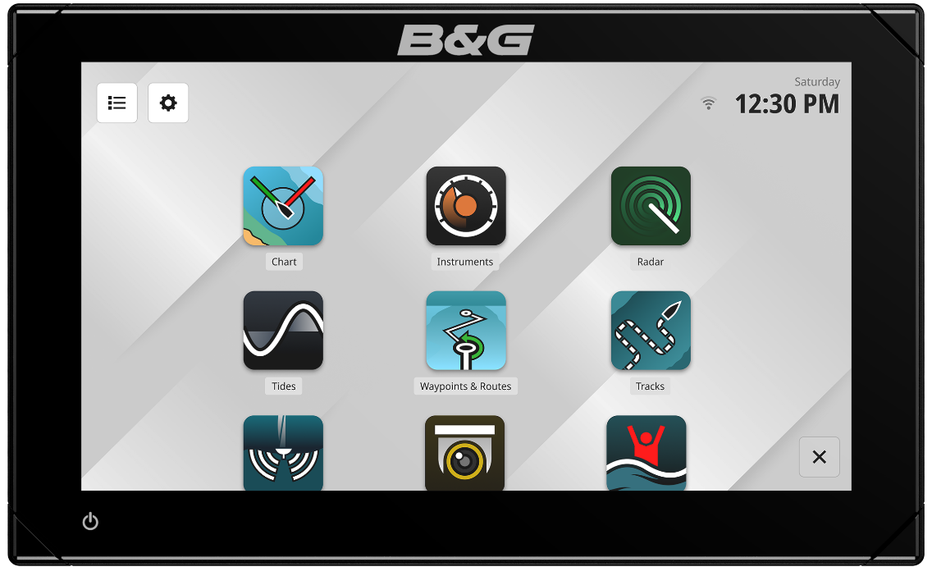
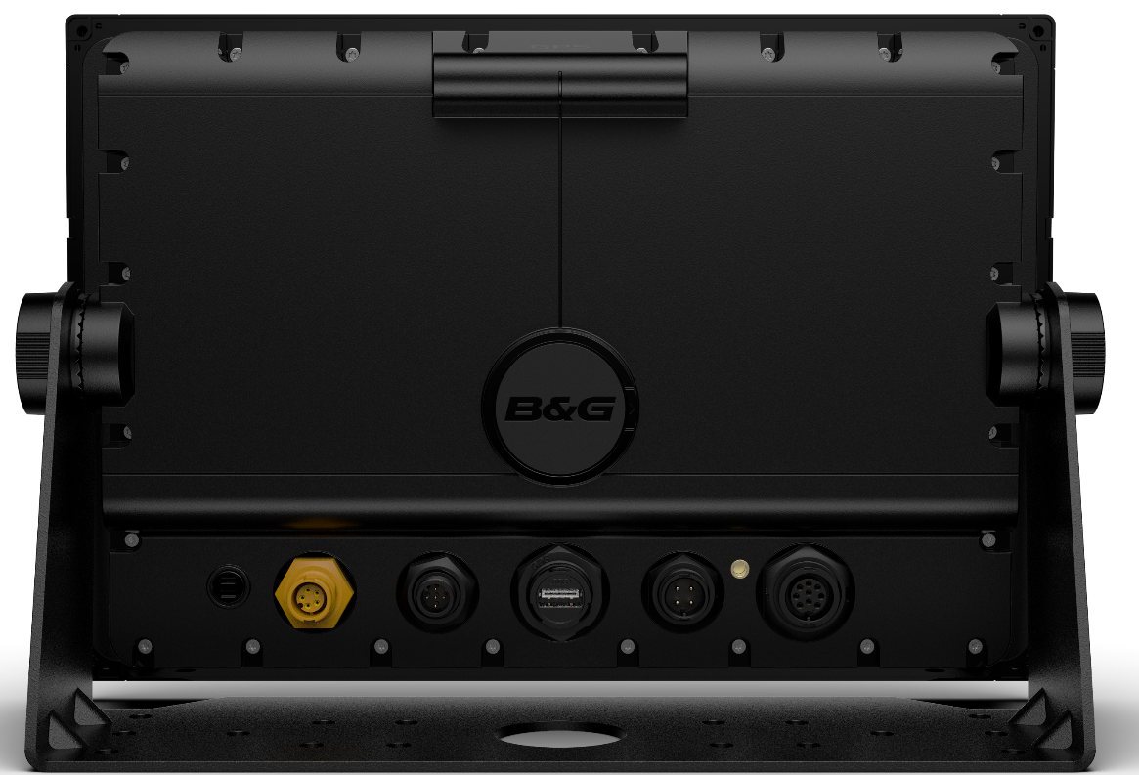
Zeus® S - Overview
1
12V power supply - 4 pin with yellow ignition
2
Latest industrial-spec Quad-core micro processors
5
3
NMEA 2000® compliant interface (Micro-C)
4
Ethernet, 100mbps, waterproof
5
Dual Wi-Fi (802.11g) for Over The Air software upgrades and B&G App support
11
10
6
Waterproof Micro SD card slot
12
7
IP67 Environmental rating
2
USB Port (Zeus S 9 & 12)
7
8
6
9
Sonar – CHIRP / Single Frequency, StructureScan, ActiveImaging and TotalScan support
4
3
8
1
9
10
Internal GPS with sail-specific filtering and 10Hz position updates. GLONASS, Galileo, Beidou and QZSS constellation support for highly-accurate positioning worldwide
11
Ultra-bright IPS SolarMAX™ HD display
12
Touch screen for quick and simple operation. Includes touch-lock feature

Slide 4
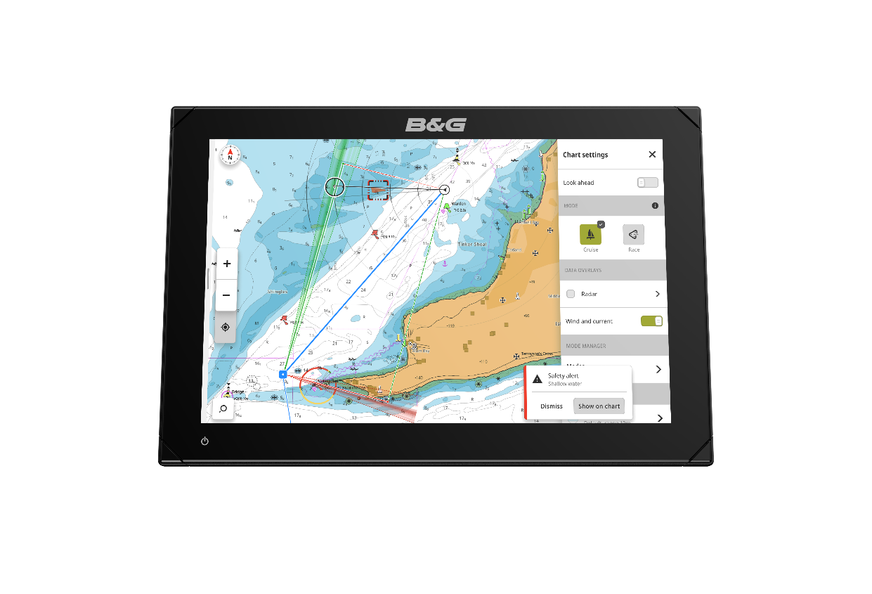
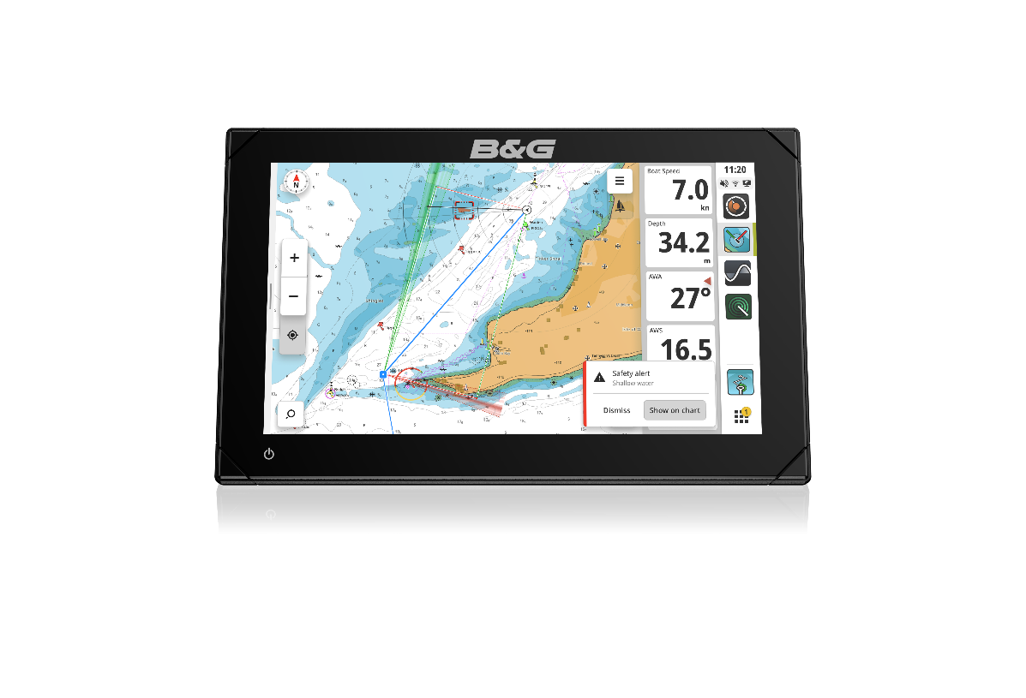
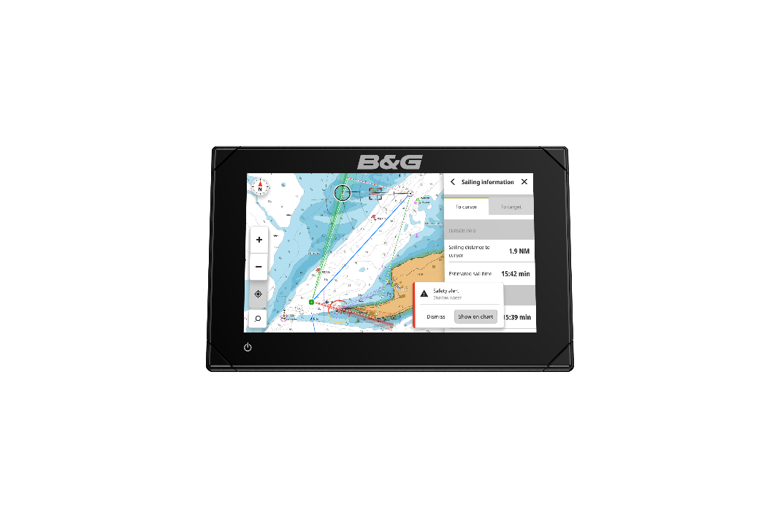
Zeus® S - Screen options
Zeus® S is available in 7, 9 & 12” display options, utilising the latest SolarMaxHD™ IPS screen technology, optimised for wide viewing angles and in bright sunlight – even when wearing polarized sunglasses.
12”
9”
7”
Zeus S 7
Zeus S 9
Zeus S 12

Slide 5
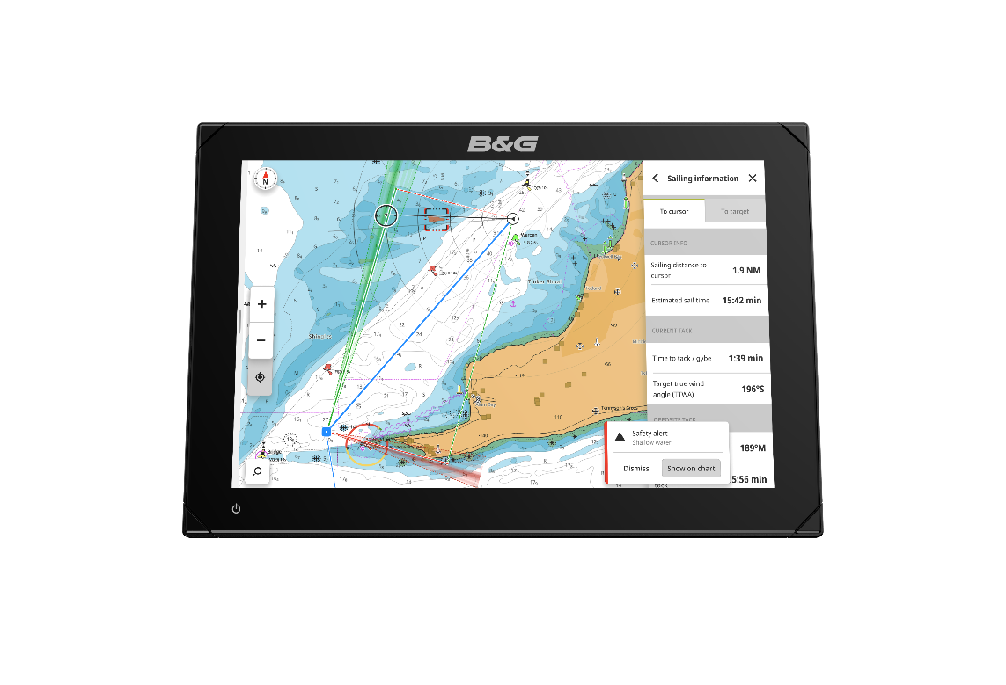
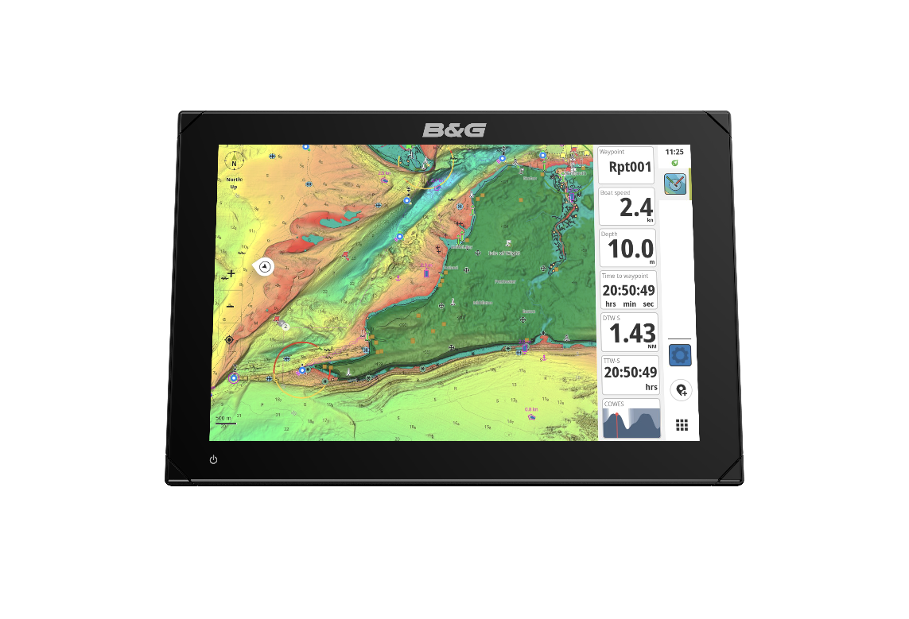
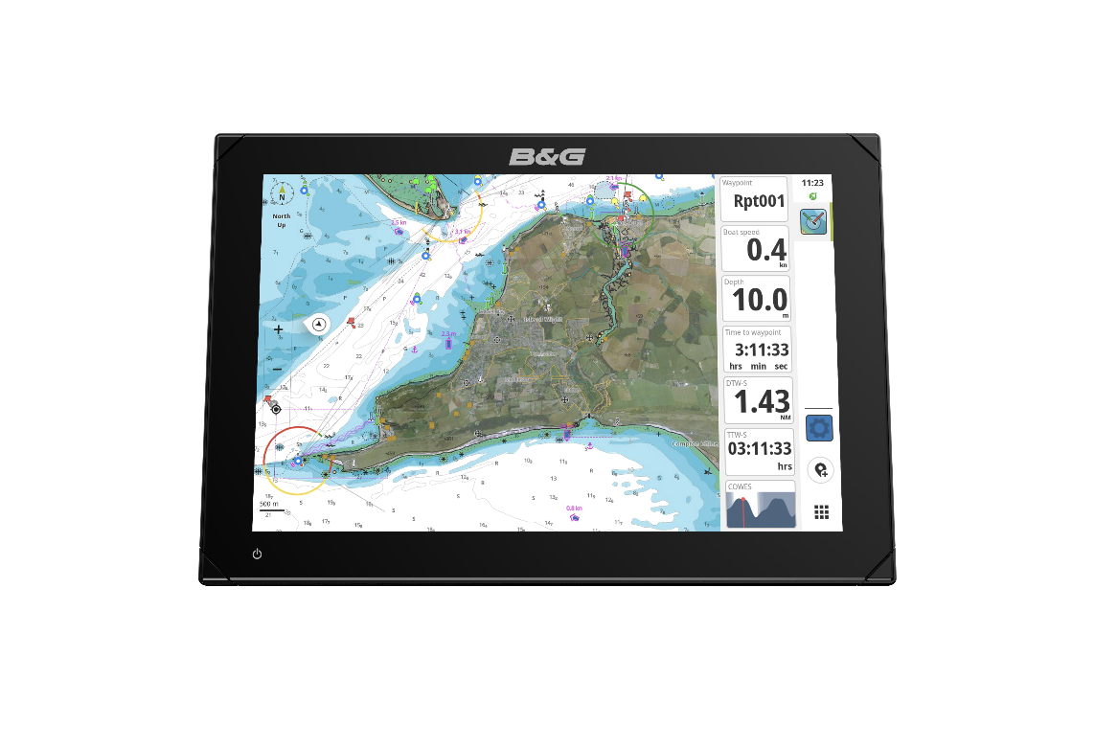
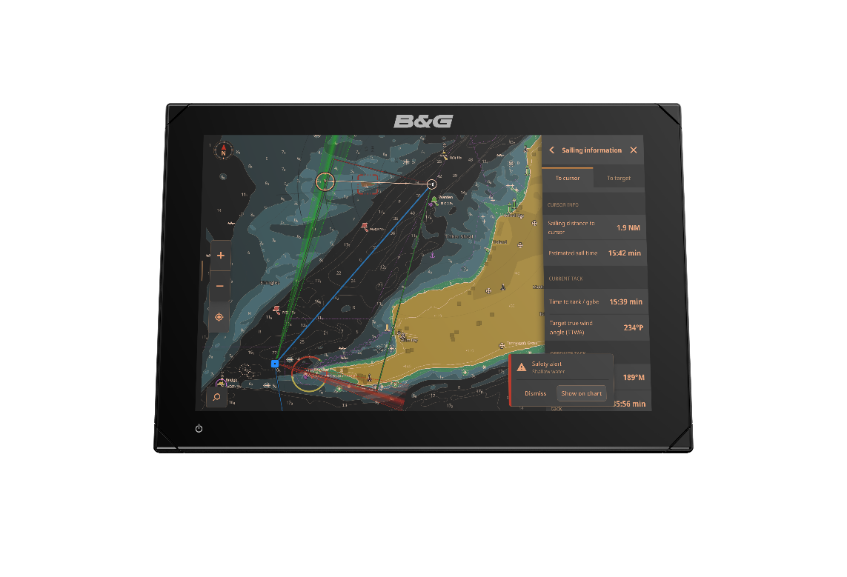
Zeus® S - C-MAP® Cartography
Compatible with the latest C-MAP® DiscoverTM X and RevealTM X cartography providing up-to-date charting detail with a clean and modern look.
Powerful chart overlays for
  Radar
  High Resolution Bathymetric contours (HRB)
  Shaded Relief*
  Satellite Imagery*
  Chart features include
  Chart Safety Alerts
  Tides and Currents
  Night Mode
  Chart Inspector tool
  Subscription-free Auto-routing
  Custom depth-shading
* C-MAP Reveal™ X only
Some features require additional system components (e.g. radar).
Clean and Modern Charts
Reveal Shaded Relief
Satellite Imagery
Night Mode

Slide 6
Zeus® S – Sailing Features
User Experience
Instruments
Simple Home screen with easy to find features
Sailing modes – Cruise & Race, just the data you want
Multihull & Monohull characterisation
Night mode optimised for low light conditions
Configurable to suit your requirements
Sailing dashboards
Dashboard editor
SailSteer™ gauge
Tide Gauge
Data Bar – prestart, upwind, reaching, downwind
Triton® Edge integration
Rotating mast support for wind and radar
Charting
Racing
Clear C-MAP X charts
Safety Alerts
Laylines with wind history
Sailing Time to Cursor position
Chart orientations: Wind up; Target up; Start Line up
Quick race entry
Race overview
Race timer
GPS start timer
Start line tools

Slide 7
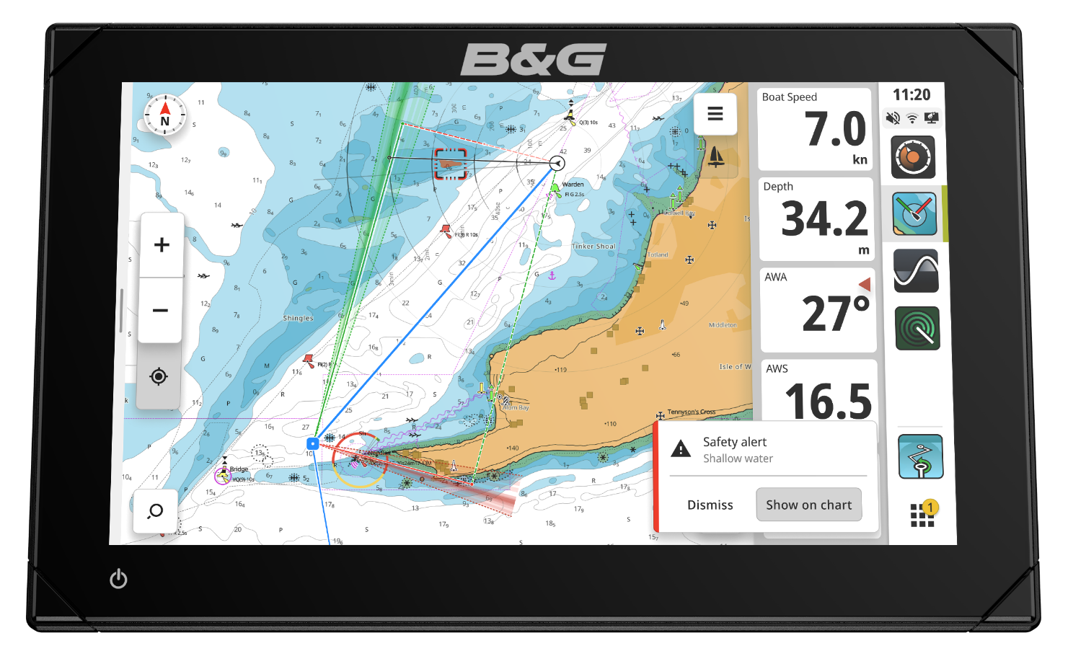
Zeus® S – Cruise mode
Cruise Mode inhibits race features for a clean display – the right tools at the right time
Chart Safety Alerts
Sailing Laylines
SailingTime & Distance to Cursor
Subscription-free auto routing
Tides & Currents
Chart Inspector
Cruise Mode enabled: showing laylines and chart safety alerts

Slide 8
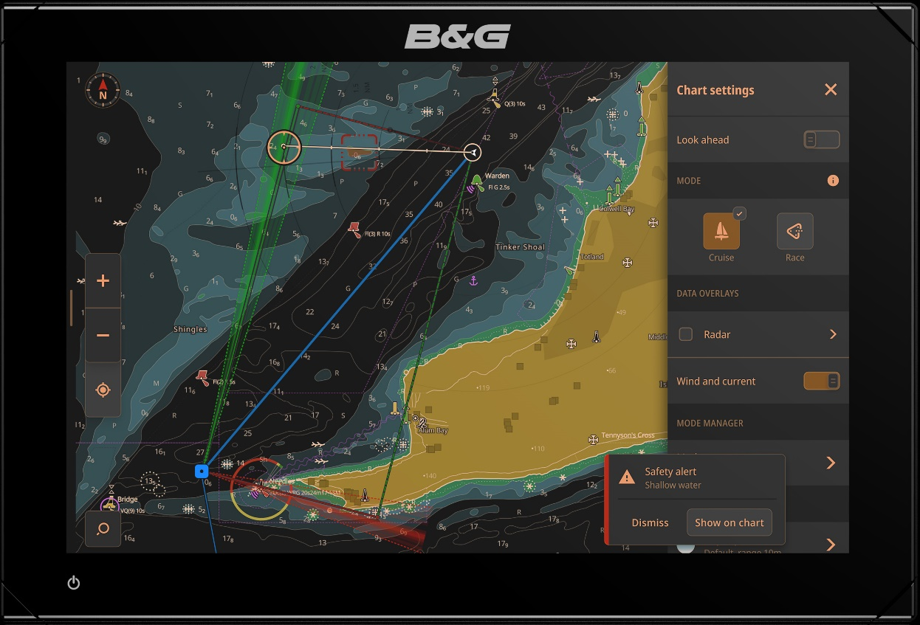
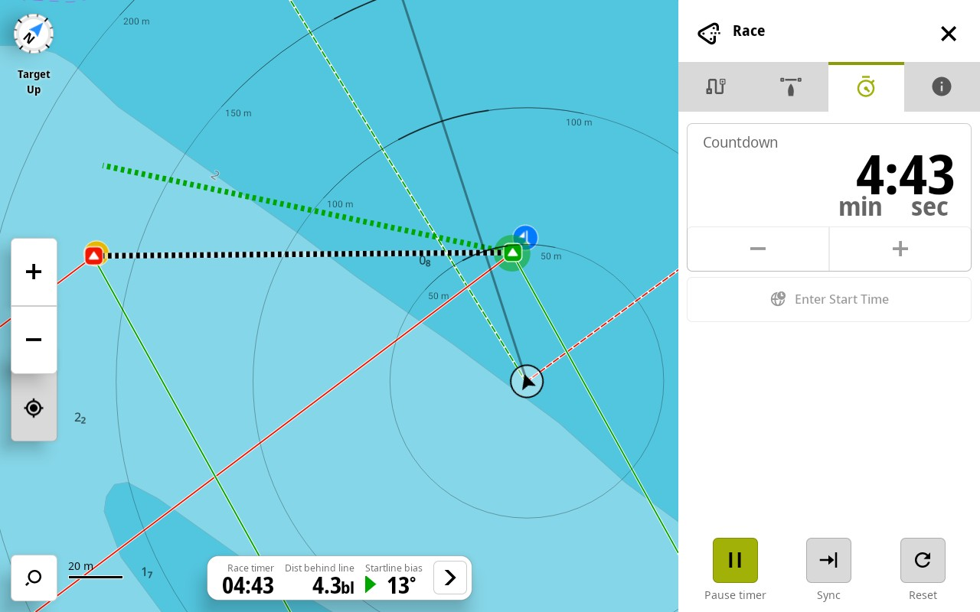
Zeus® S – Race mode
Race Mode enables additional features for racing – the right tools at the right time
Start Line
Race Timer
Quick Route Entry
Race Overview
Race Mode enabled: showing start line with laylines, line bias, range-rings and Race Timer controls

Slide 9
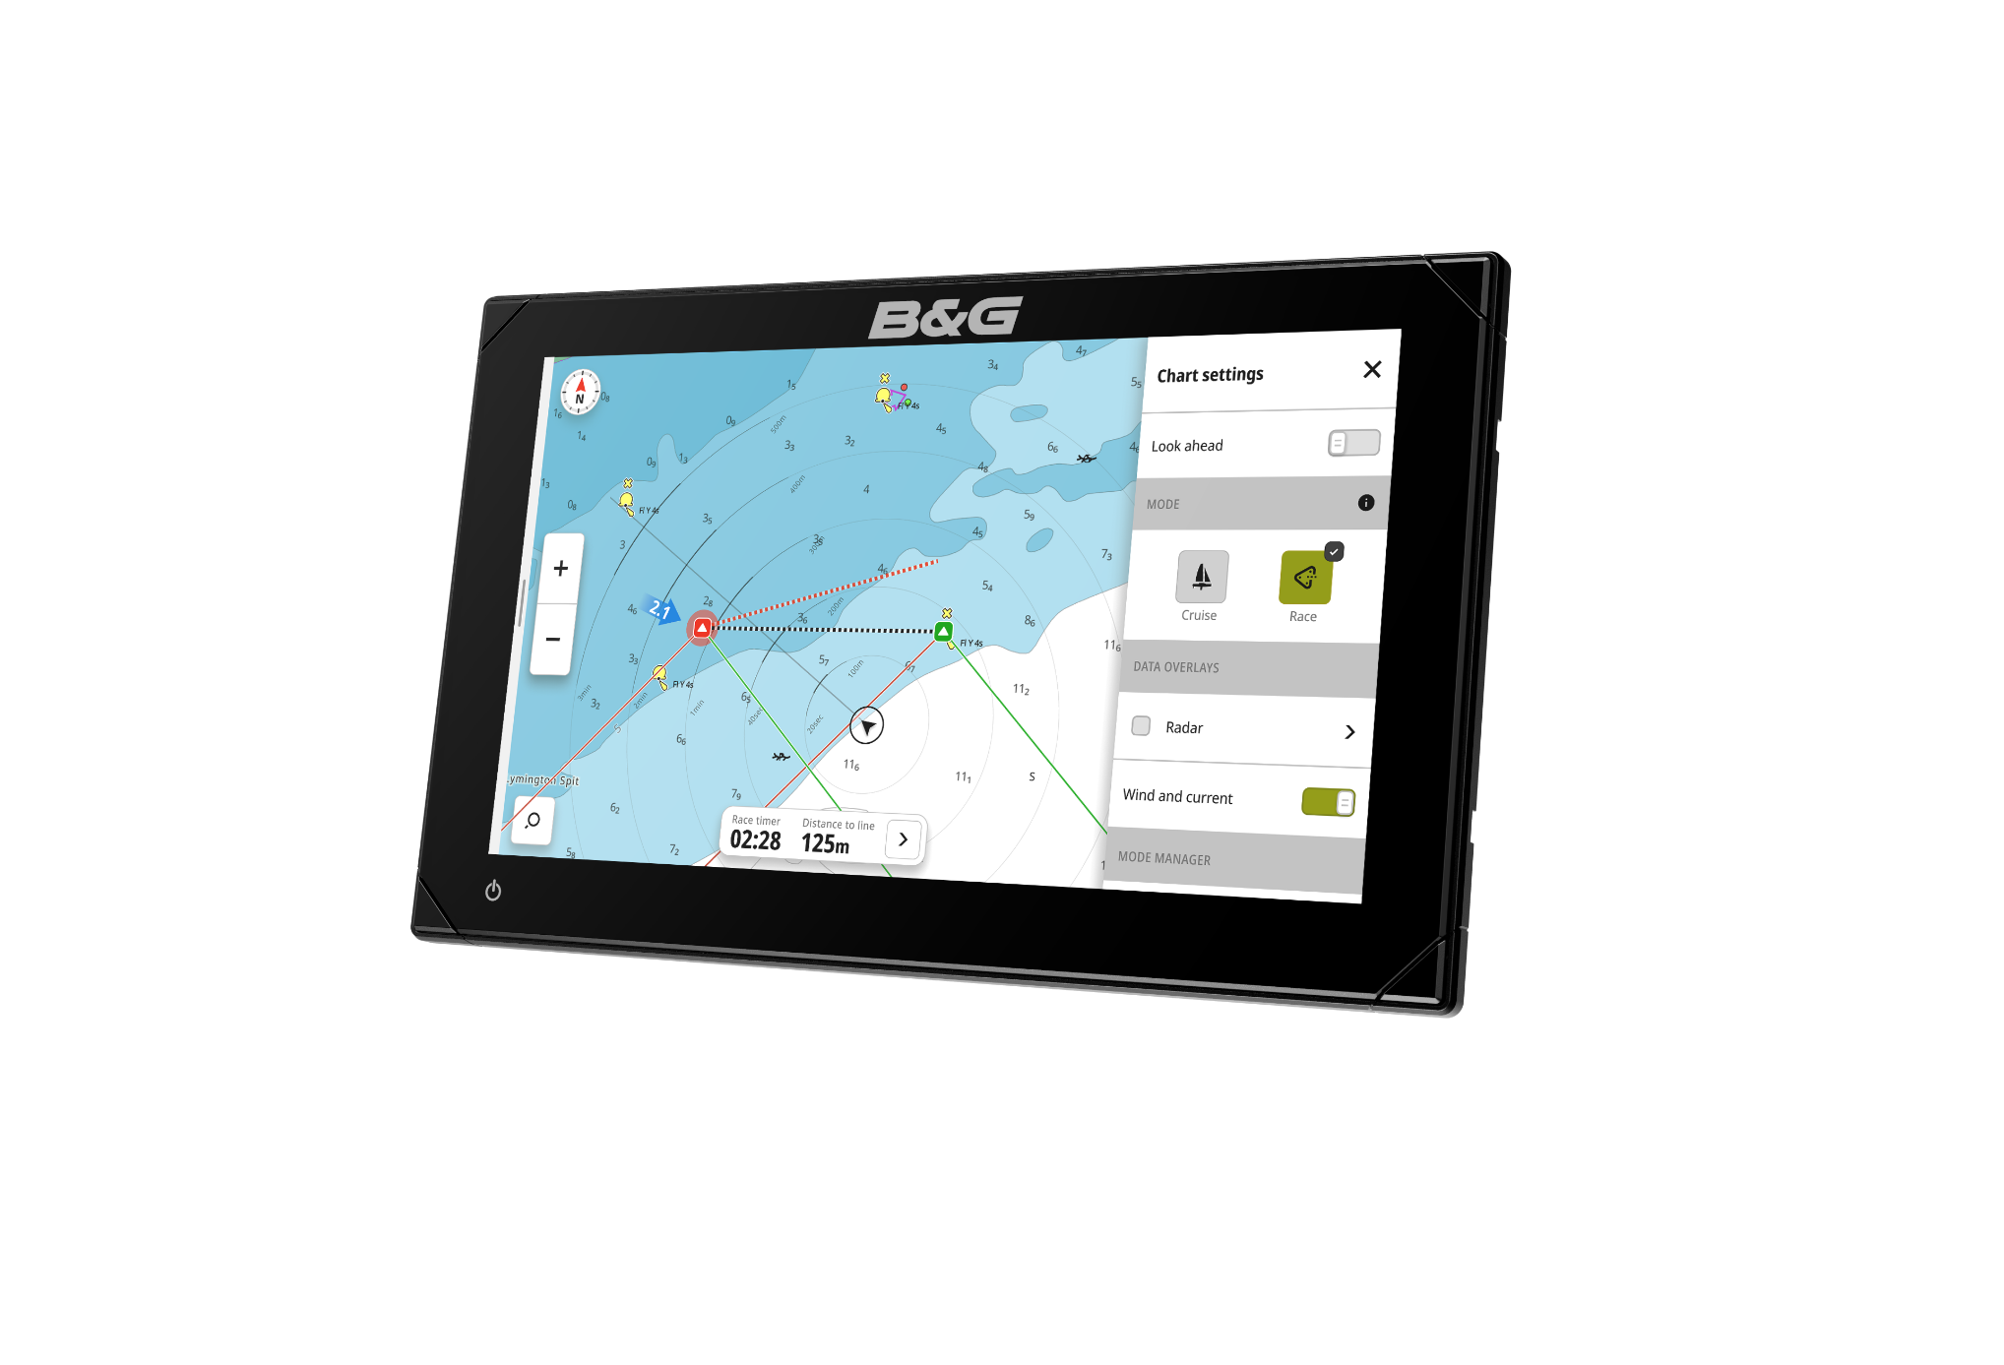
Zeus® S - Sailing modes
Easily switch between Cruise or Race sailing modes
Race mode enables additional features:
  Quick race route entry
  Port / Starboard waypoint rounding indicators
  Race leg(s) overview
  Start line chart overlay with:
    Set the start line
    Apply GPS offset for bow position
    Bias indicator
    Tide and wind indicators
  Race timer
    Countdown timer
    Start/Stop/Sync/Reset
    Countdown to GPS start time

Slide 10
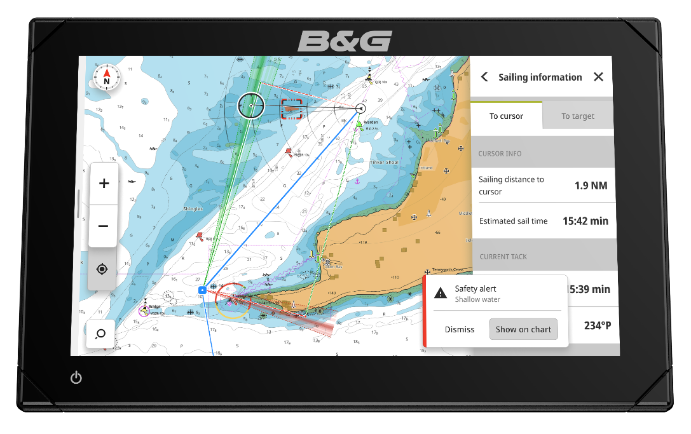
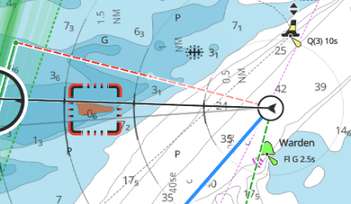
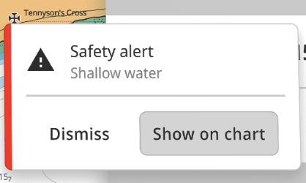
Zeus® S - Safety Alerts
The NEW Safety Alerts feature included with Zeus S can constantly monitor your course for dangerous chart objects - no matter what your speed, zoom level or view. Whether it’s a buoy, shallow water, rocks or land - Zeus S can warn you in advance.
C-MAP® DiscoverTM X and RevealTM X charts provide detailed chart data - available at all times to Safety Alert
Alerts provide the sailor with awareness of potentially dangerous charted objects above and below the waterline
Automatically identify charted objects which are of a concern, warning or critical based upon their relative time and distance
‘Harbor’ and ‘Offshore’ modes allow Zeus S to automatically change the time and range sensitivity based on use
Ideal for use in unfamiliar waters or at night when visibility is reduced to identify dangerous objects.
Safety Alerts feature requires a compatible C-MAP® Discover X or Reveal X chart covering the area around the vessel.

Slide 11
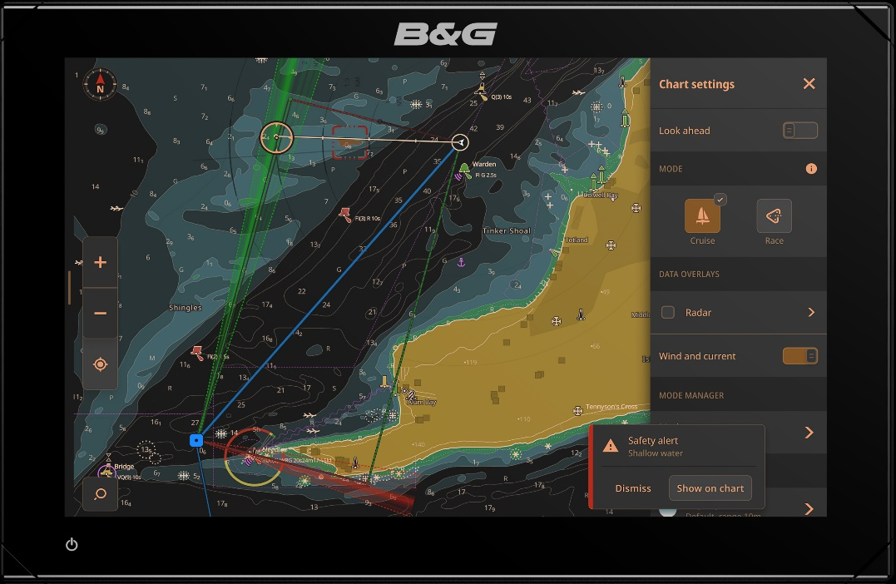
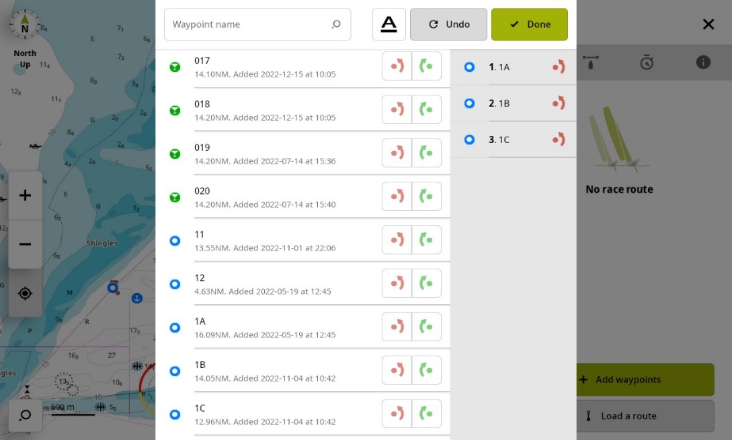
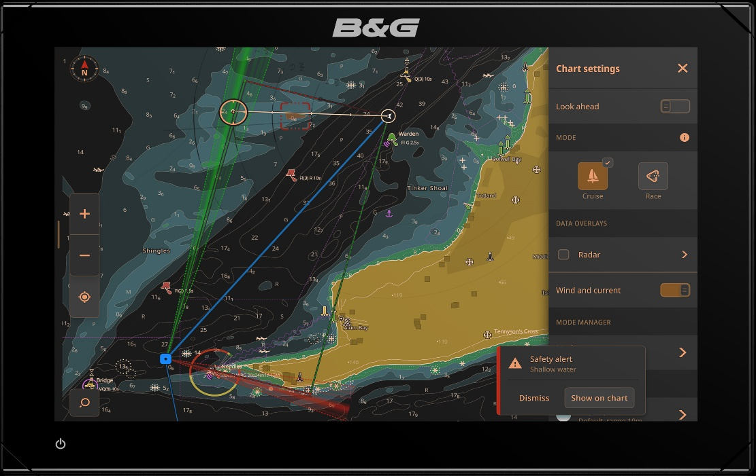
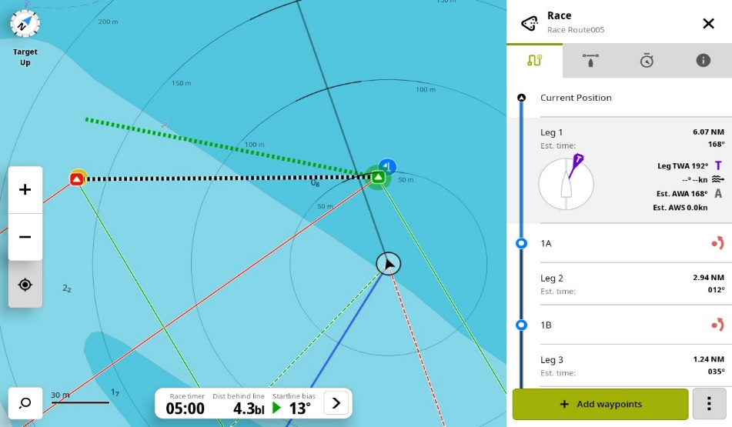
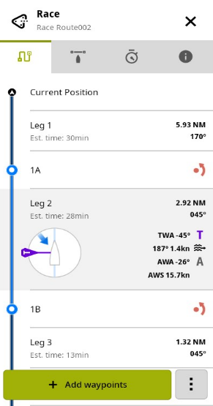
Zeus® S - Quick Race Entry
  Quickly create a race route from sorted list of waypoints
  Easily add port and starboard rounding indicators
  Intuitively add, remove or reorder a race route
  Use the Race overview tool to brief your race crew with expected wind angles and estimated sailing time for each race leg to aid decision making and sail selection

Slide 12
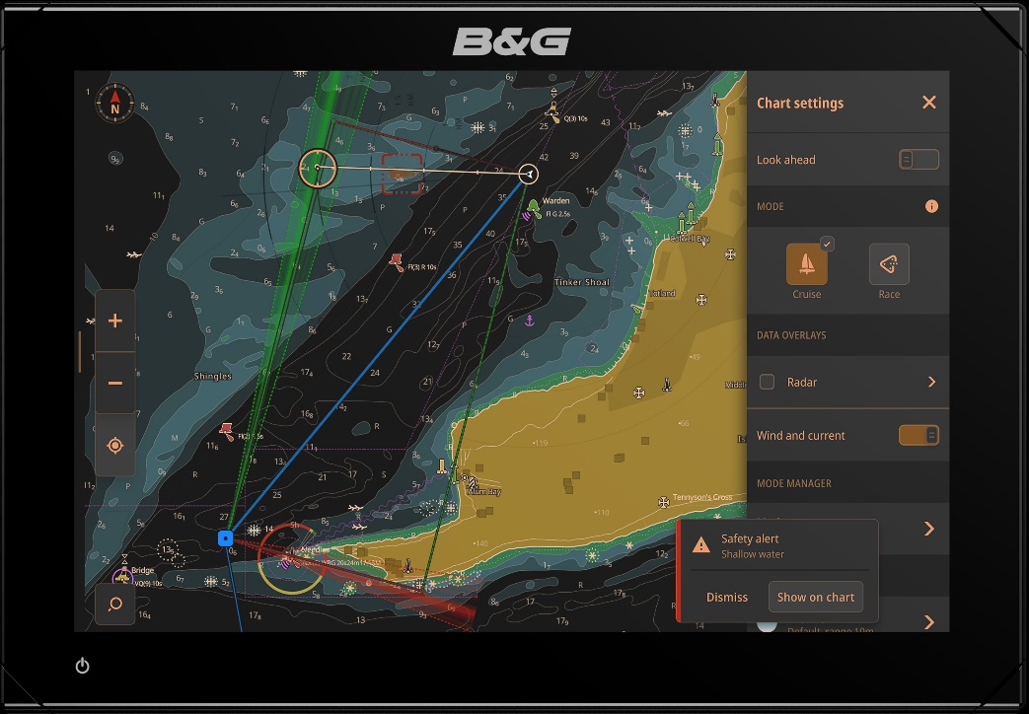
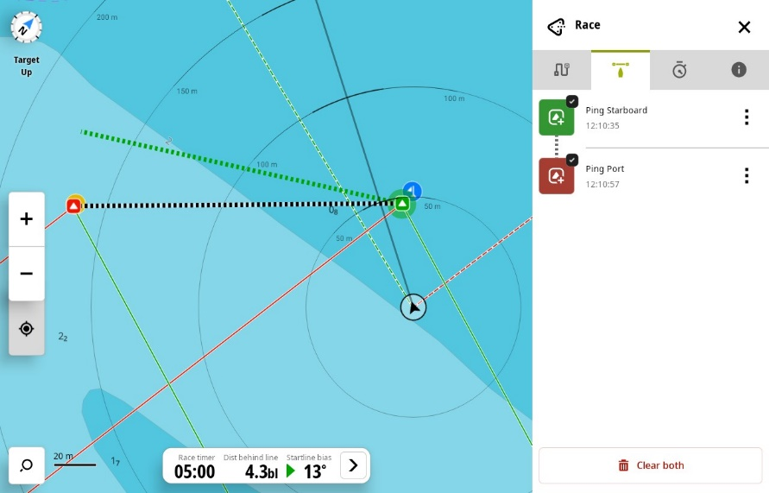
Zeus® S - Start line
The powerful Zeus Start Line tool is now chart-based to allow navigational awareness during the start procedure
Start line view, including laylines, favoured end, tide set & rate and True Wind Direction
Chart dynamically orientates and zooms to ensure boat and start line are in view
Calculations are based on the yacht’s Bow Position via an offset distance for the GPS
Zeus S Internal GPS (or optional external options) provide precise position 10 times per second
Simple setup - set the port and starboard start line end positions via a button press (“ping”), waypoint or cursor
Easily return to view the start line on the chart via an edge marker
Zeus S automatically captures your distance to line when the race timer reaches zero
The following start line data is calculated and displayed:
  Distance behind line (boat lengths or meters)
  Distance to line
  Distance to port & starboard ends
  Start line bias to True Wind Direction
  Bias advantage

Slide 13
Zeus® S - Race timer
Race Timer provides a flexible and integrated tool for starting and monitoring race duration
Quickly adjust the race timer start value
NEW Set the race timer to countdown to a GPS based start time. e.g. 1900h
Race timer control is available from networked devices
Start, Stop, Sync [to nearest minute] and Reset functions
Automatically starts a stopwatch when the race timer reaches zero to track race duration.

Slide 14
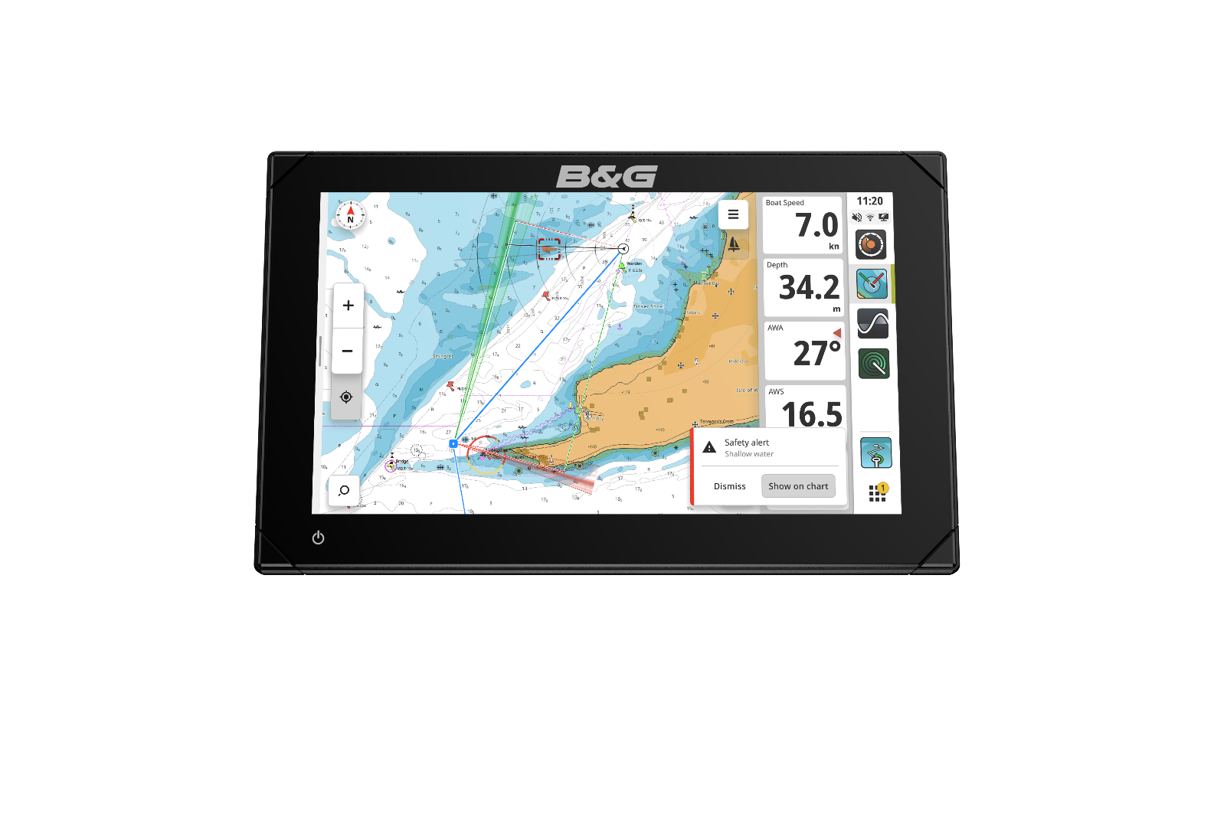
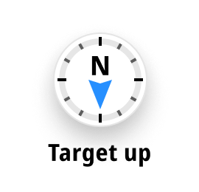
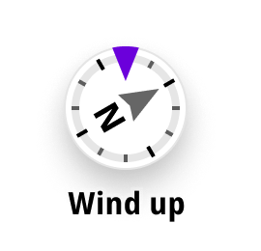
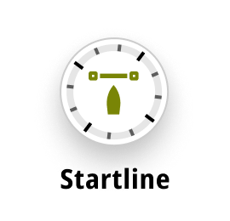
Zeus® S - Chart Orientation
Easily rotate the chart to aid understanding and make better decisions for your route or race course
Single touch rotates between:
  North up
  Heading up
  Course up (Course over Ground)
  NEW Target up (Waypoint)
  NEW Wind up (True Wind Direction)
  NEW Start line up

Slide 15
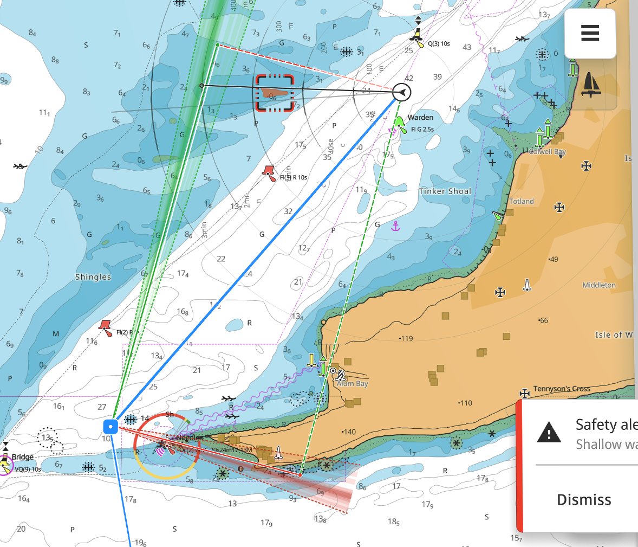
Zeus® S - Laylines
B&G pioneered laylines in chart plotters with the original Zeus®. Zeus S laylines provide a powerful decision aiding tool.
Overlay your target sailing angles, upwind or downwind, to your destination on the chart
NEW Enable wind history to show a wind shift heat map, which intensifies the colours over time to show the history of true wind direction
NEW Mini-Inspect (short press) a layline to gain detailed target sailing angles, speed, SailingTime and distances
NEW Full-Inspect provides detailed sailing information on current and opposite tacks
Apply tidal correction to layline calculations
Display laylines using actual data or input targets.

Slide 16
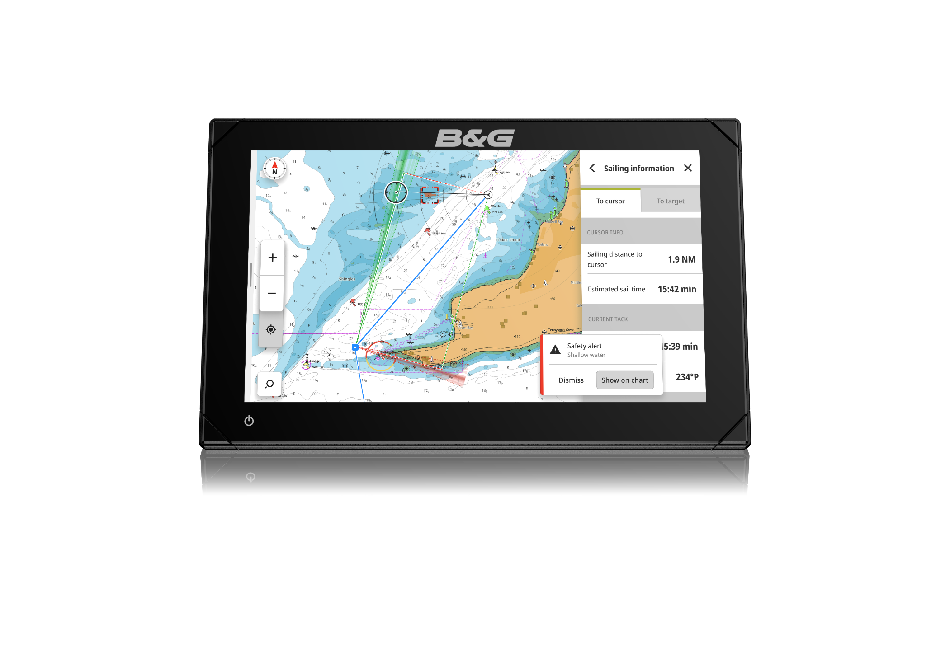
Zeus® S - Time to cursor
NEW Have you ever wanted to know how long it will take to sail to a location on the chart or you need to tell your race crew how long to go ?
Simply place the cursor anywhere on the chart to show an estimated sailing time and distance information to the cursor position.
Ideal, when you’re navigating to a waypoint and you need to know sailing time to a secondary position.

Slide 17

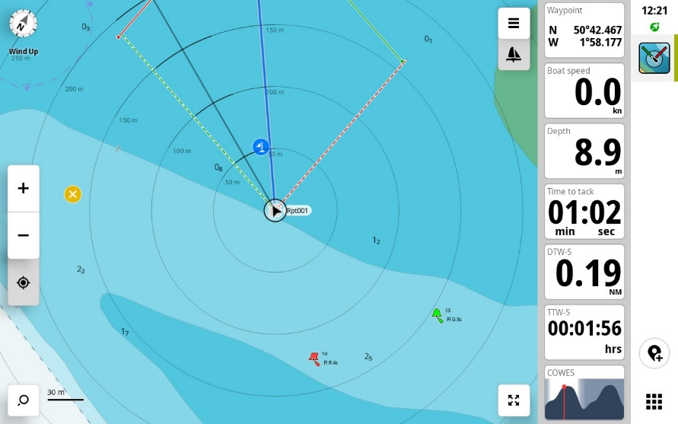
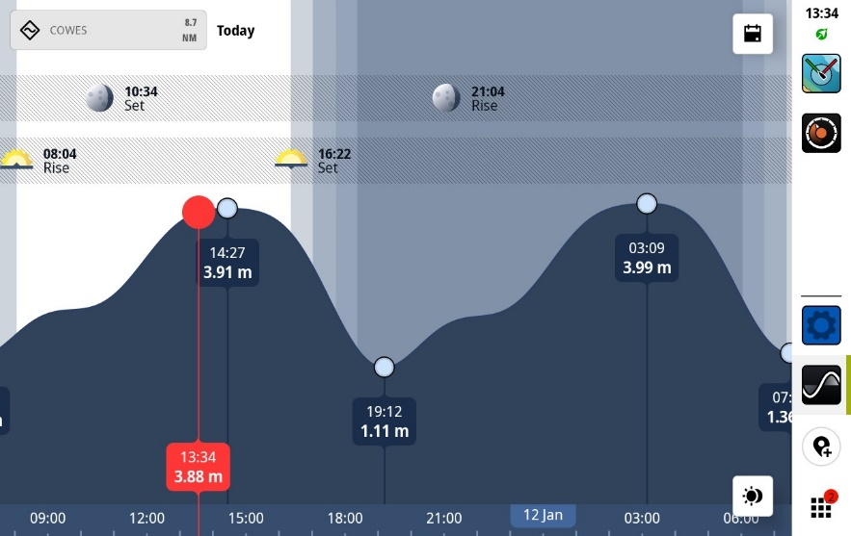
Zeus® S - Tide Gauge
Need to know the state of tide quickly? Zeus S provides at-a-glance tidal data
Graphically see a tidal histogram including current time indication in the instrument data bar
Choose between automatic selection of the closest tidal station, or select a specific station
More detailed tidal data is available via the chart icons

Slide 18

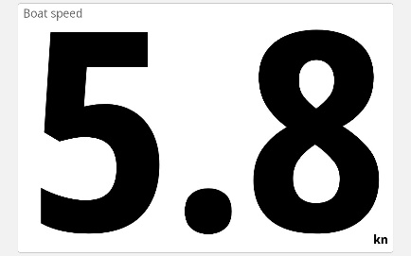
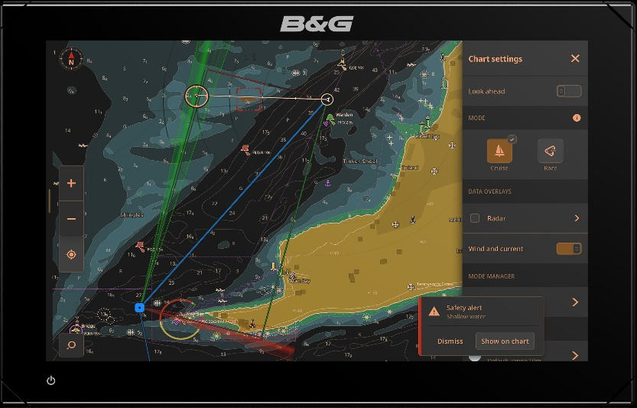
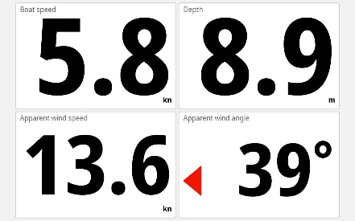
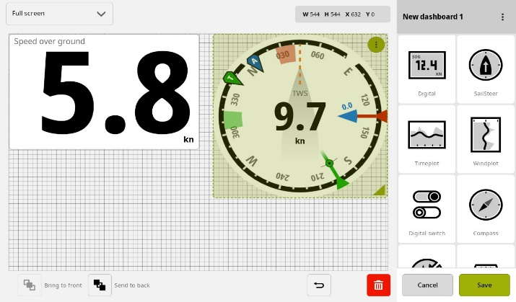
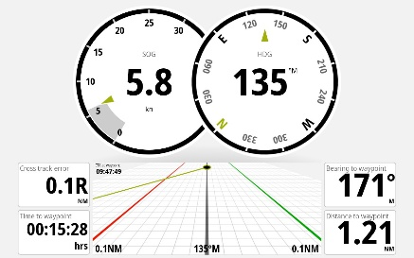
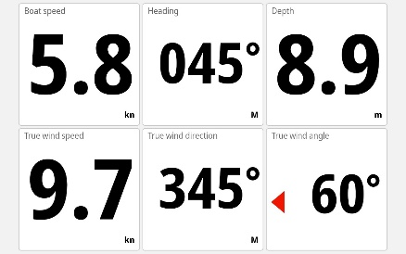
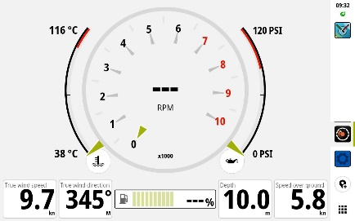

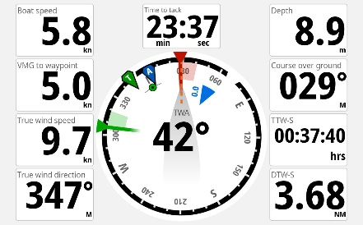
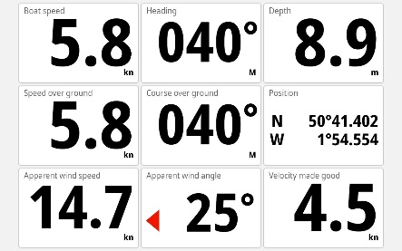
Zeus® S - Instruments
Clear and easy to read instrument dashboards
Quickly swipe between dashboards
Create your own design using the dashboard editor.

Slide 19

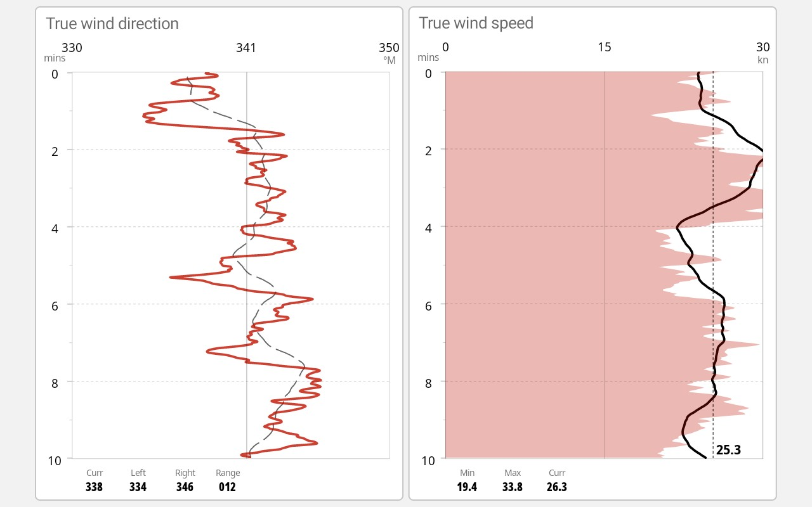
Zeus® S - Wind plot
Dedicated wind charts for monitoring wind history and assessing trends
User configurable options include:
Show Trend lines
Show tack colour (port / starboard)
Show Average
Min, Max and current value
Time range 1,5,10,30 or 60 minutes

Slide 20

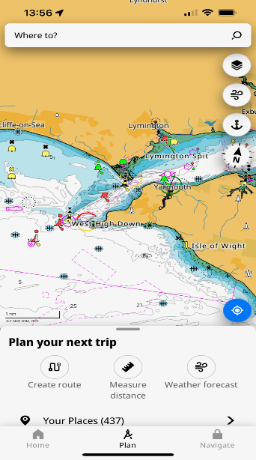
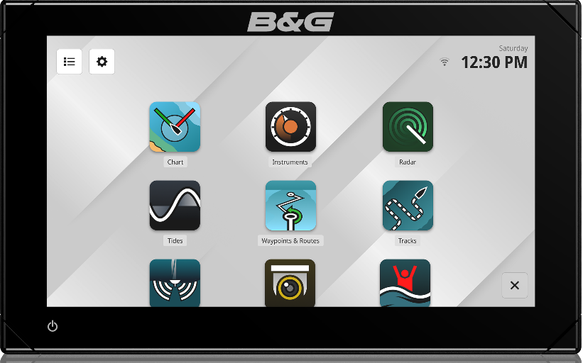
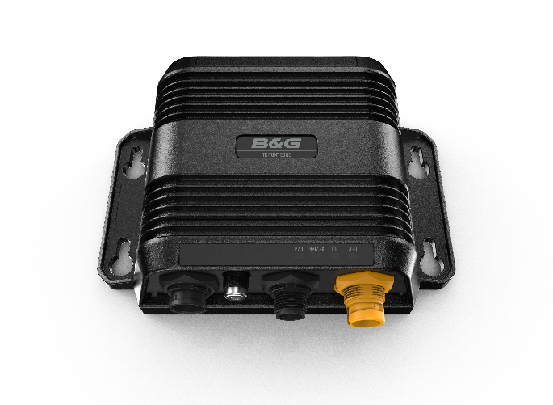

Zeus® S – B&G Companion App
Download the latest B&G App
Plan & review your waypoints and routes using the latest C-Map® charts
Seamlessly synchronise waypoints and routes between products
Review your sailing data from Triton® Edge
Register new products and access support information
Complete product software updates
Triton® Edge Sailing Processor

Slide 21


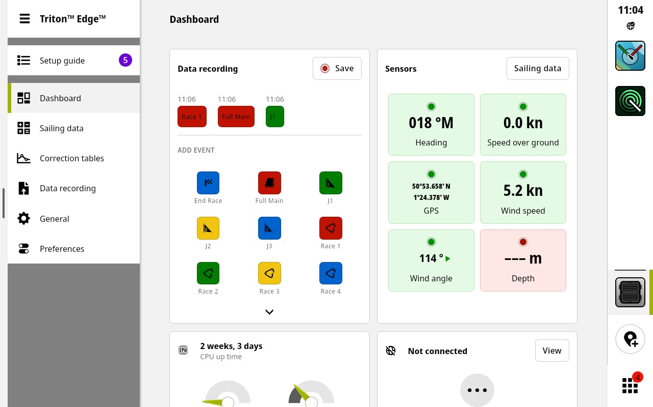
Zeus® S - Triton Edge Integration
Adding a Triton® Edge Sailing processor to your system provides advanced wind, calibration and data recording. Zeus S provides a seamless integration with Triton Edge.
Display all B&G NMEA2000® performance sailing data
Seamlessly access the web interface on Triton™ Edge
  Control and system setup
  Perform advanced calibration
  Control data recording
Connect via Ethernet or Wi-Fi
Triton Edge
Sailing Processor
Triton Edge interface via Zeus S display

Slide 22
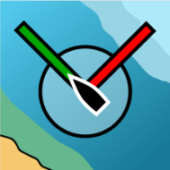
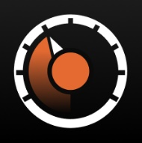
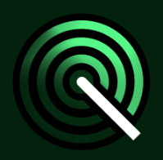

Zeus® S – Feature Summary
Chart
Instruments
Radar
Sonar
Sailing Modes - Cruise & Race
Safety Alerts
Laylines
Start line
Wind up mode
Target up mode
Quick race route builder
Race overview
Sailing time and distance to cursor
User configurable dashboard(s)
Swipe left/right to change dashboards
Instrument data-bar
Data bar tidal gauge feature
Compatible with Halo 20, 20+, 24+ radar with velocity track & dual radar features
Improved dock and on the water commissioning process
Compatible with 4G broadband
Sonar support
Traditional Sonar
CHIRP Sonar
DownScan
SideScan

Slide 23





Zeus® S – Feature Summary
Waypoints & Routes
Tracks
Tides
IP Camera
Manage Waypoints & Routes
Sync with user account via App
Review sailing tracks
Sync with user account via App
Access to tide and current information
Quick tide view in data bar
ONVIF IP Camera support
Supports Navico IPCAM-1
Picture in Picture
Triton™ Edge
Integrates directly with Triton™ Edge Sailing processor
Seamless access to the Triton™ Edge web interface

Slide 24







Zeus® S - NMEA2000® System example
Minimum Requirements for Sailing Features: GPS [integrated or external], Heading, Boat Speed & Wind
NMEA2000
System connections are illustrative only.

Slide 25

Zeus® S – Dual display system example
Minimum Requirements for Sailing Features: GPS [integrated or external], Heading, Boat Speed & Wind
Network sharing:
C-Map® Discover® X and Reveal® X Charts
Waypoints & Routes
Radar
Ethernet
Connection of more devices may require an NEP-2 Network Expansion Port. System connections are illustrative only.

Slide 26

What’s in the box
Zeus STM display unit
Panel mounting kit
Sun Cover
Corner clips
Power Cable (2.0m)
Fuse holder and fuse
Installation guide and quick star documentation
Mounting U-bracket
Note
NMEA2000 and Ethernet cables are not included and should be ordered separately if required
Optional Accessories
Ethernet Cable 1.8m / 6’ | 000-0127-001
Ethernet Cable 4.5m / 15’ | 000-11246-001
Ethernet Cable 7.6m / 25’ | 000-0127-30

Slide 27

Zeus® S 7 – Dimensional Drawing

Slide 28

Zeus® S 9 – Dimensional Drawing

Slide 29

Zeus® S 12 – Dimensional Drawing

Slide 30
Zeus® S - Technical Specification
Environmental
Operating temperature | −15 to 55ºC (5 to 131ºF)
Storage temperature | −40 to 85ºC (−40 to 185ºF)
Waterproof rating | IPX6; IPX7
Electrical
Supply voltage | 12V DC nominal (10-17V DC)
Physical
Weight | 0.8Kg (Zeus S 7) 1.2Kg (Zeus S 9) 2.2Kg (Zeus S 12)
Compass Safe Distance | 0.5m (1.6’)
Interface/Connectivity
NMEA 2000® | 1x Micro-C
Ethernet | 1x Navico 5-pin yellow
Wi-Fi | 802.11 b/g; Internal antenna
Display
Viewing Angles | 85° (top, bottom, left and right)
Screen brightness | >1200 nits
Display resolution | 1024 x 600 px (Zeus S 7) 1280 x 720 px (Zeus S 9) 1280 x 800 px (Zeus S 12)

Slide 31
NEW ZEUS® S
SAILING, SIMPLIFIED

